Slide 1
Amazon Share Analysis
File created on: 02-06-2022 10.16.25 AM

Slide 2
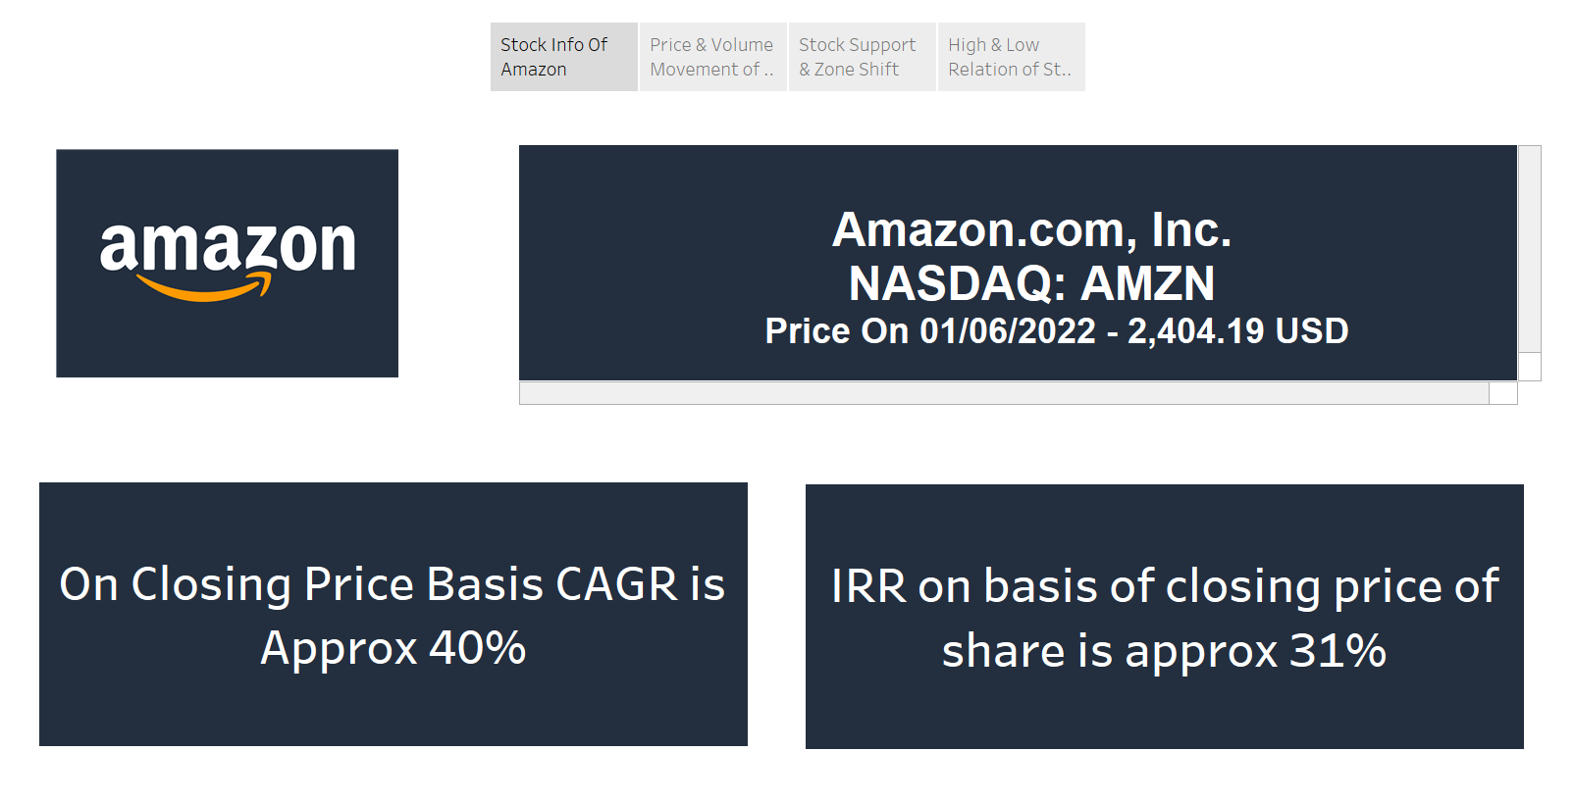

Slide 3
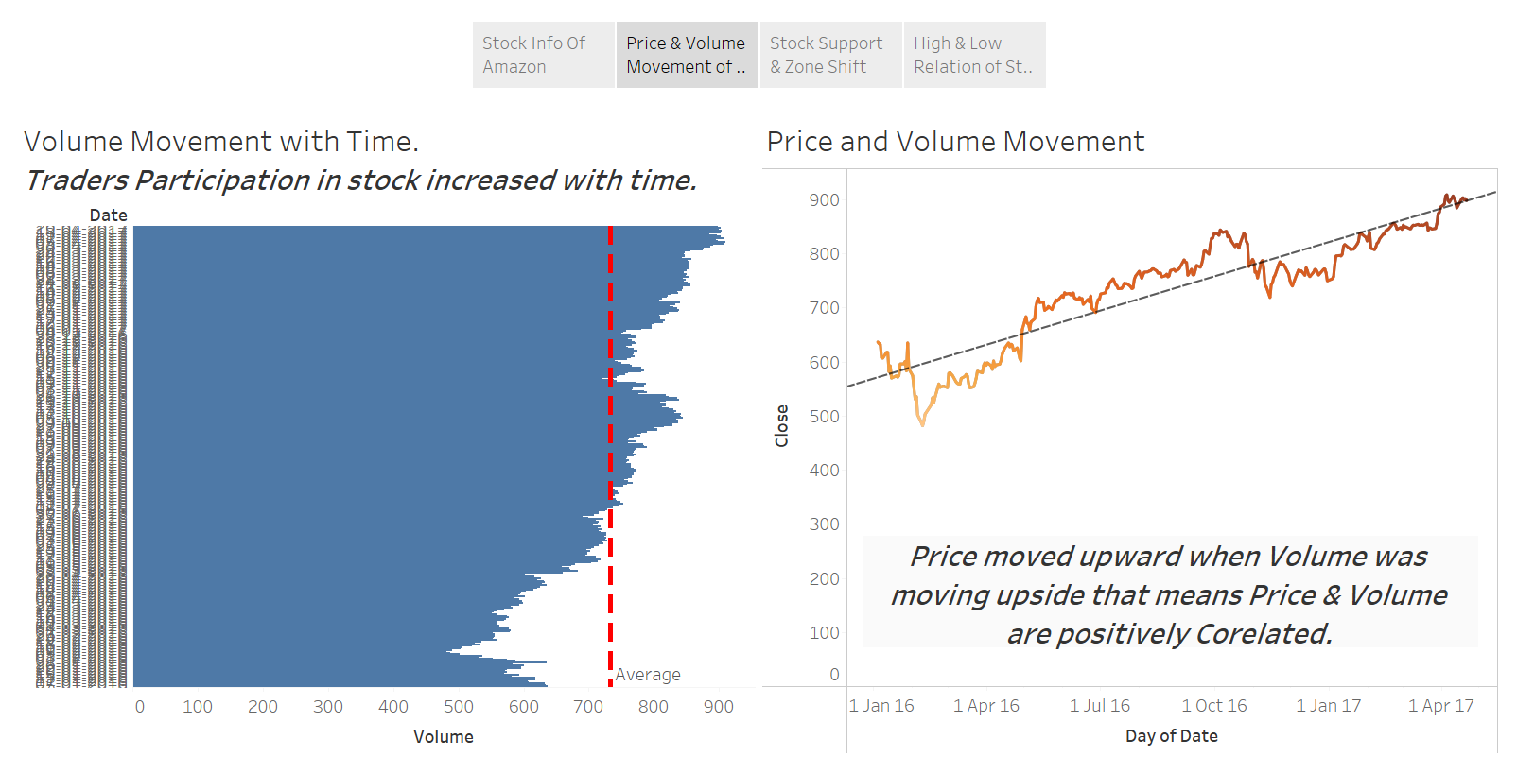

Slide 4
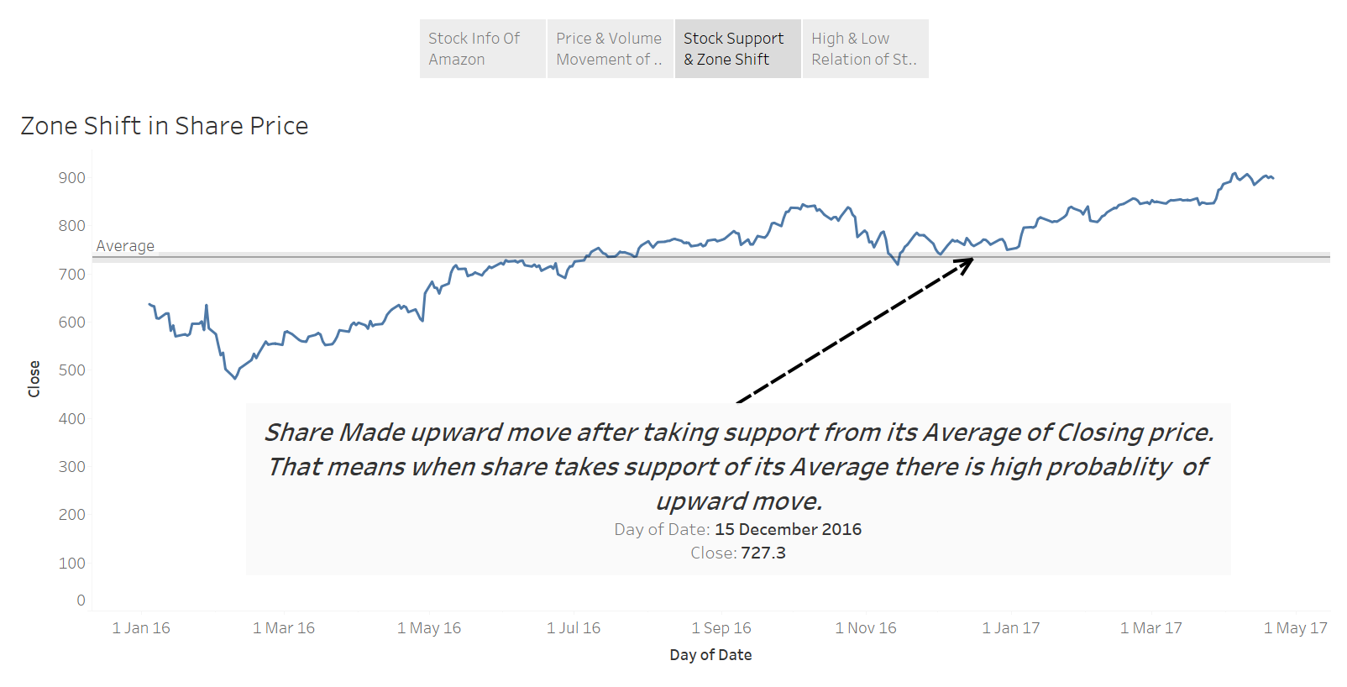

Slide 5
